Slide 1
AIrBNB booking analysis capstone project
Created By: Anil Gayki

Slide 2
AGENDA
About AirBnb
Business Context
Need for data analysis
Problem Statement
Understanding dataset
Data Representation as per problem statements

Slide 3
About AirBnb
Airbnb, Inc. is an American San Francisco-based company operating an online marketplace for short- and long-term homestays and experiences. The company acts as a broker and charges a commission from each booking.

Slide 4
Business Context
Airbnb's business model is based on connecting people who are looking for short-term accommodation with hosts who have space to rent out.
Airbnb makes money by charging a service fee from both the host and guest when a reservation is made.
The company also offers additional services such as Experiences, which allows travelers to book unique activities led by local experts, and Luxe, which provides high-end accommodations in select cities around the world.
By providing these services, Airbnb has become one of the most successful companies in travel hospitality industry today!

Slide 5
Need for data analysis
Data analysis on millions of listings provided through Airbnb is a crucial factor for the company. These millions of listings generate a lot of data that can be analyzed and used for:-
Security
Decisions
Understanding of customers' and providers' (hosts) behavior and performance on the platform
Implementation of innovative additional services and much more.

Slide 6
Problem Statement
When it comes to spendings on services, customer will take a deep look inside what are the facilities provided, pricings/budget, customer reviews/ratings, availability, security and location etc. So, I tried to list below analysis the customer will take a look at before going to spend on AirBnb Services.
Analysis of room types provided by AirBnB. (Which room type is more prefered by customers.)
Analysis of locations(neighbourhood_group) prefered by customers.
Analysis of average price over room type (What is price distribution based on room type)
Analysis of reviews with respect to host_names (Which host_name has more reviews)
Analysis of correlation between availability over 365 days, minimum nights paids, price and host count.
Analysis of host availability over neighbourhood_groups in percentage.

Slide 7
Understanding dataset
The dataset is the CSV file, has 48895 rows and 16 columns
Variable/Column Name | Description
id | Unique Id gets assign to each listing when they registered on AirBnb
name | Name has to enter when registered on AirBnb so that it will show in listing.
host_name | Unique id assigned to each host each listing will have unique host and host id.
Host_name | Host names who are responsible for respective site.
neighbourhood_group | Boroughs wise location details in new York city, it has details about all 5 boroughs i.e. Bronx, Brooklyn, Manhattan, Queens, and Staten Island
neighbourhood | It has area details comes under specific neighbourhood_groups
Latitude& longitude | Has coordinates details to create map based visual.
Room_type | What all types of room available
price | Price per night for listing bookings
minimum_nights | Minimum nights the listing will ask payment for
number_of_reviews | Total number of reviews listing gets
last_review | Date of last review
reviews_per_month | Average of reviews per month
calculated_host_listings_count | Listing count per host
availability_365 | No of days listing is available

Slide 8
Data Representation as per problem statements
Data is represented using below chart types:-
Bar Chart
Line Chart
Area Chart
Heat Map
Pie Chart

Slide 9
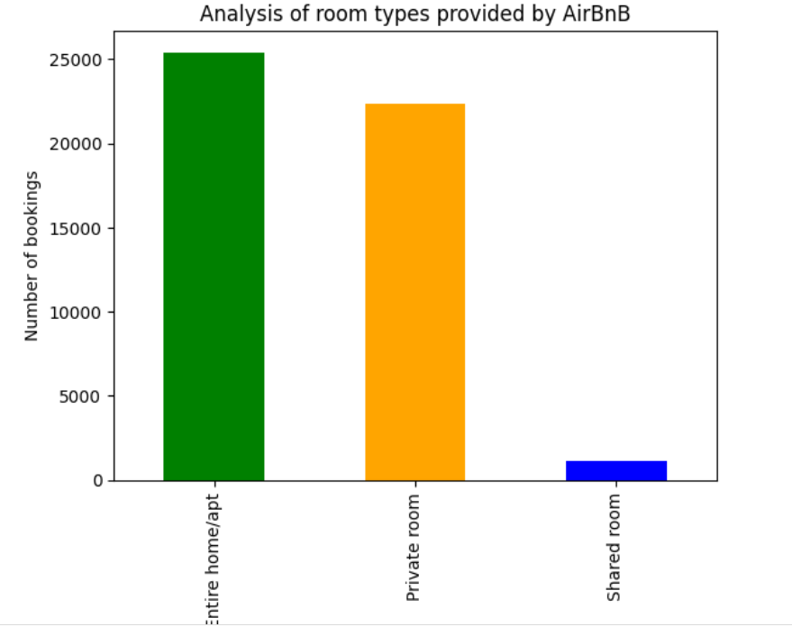

Slide 10
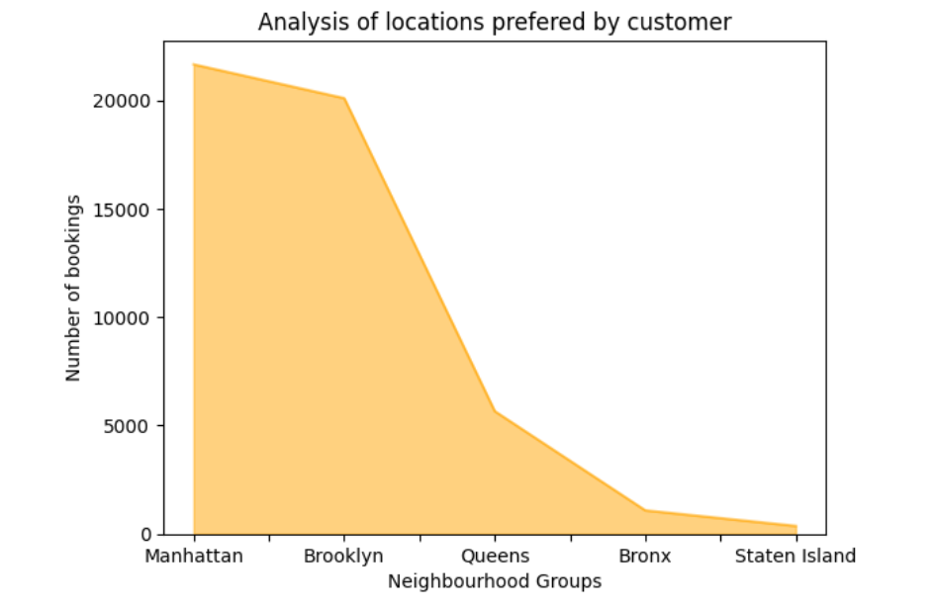

Slide 11
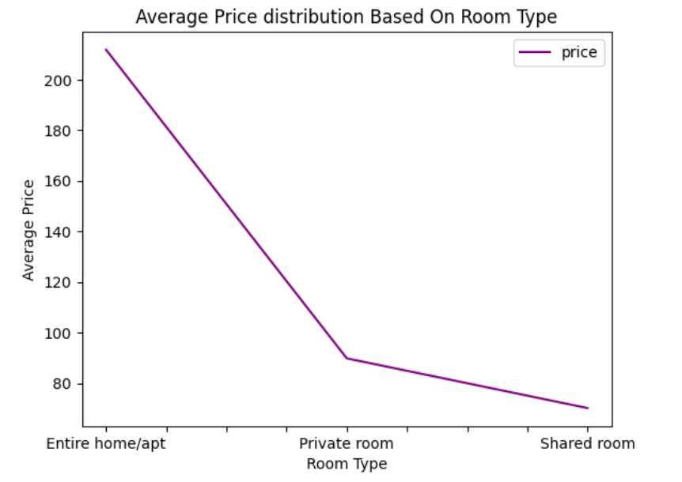

Slide 12
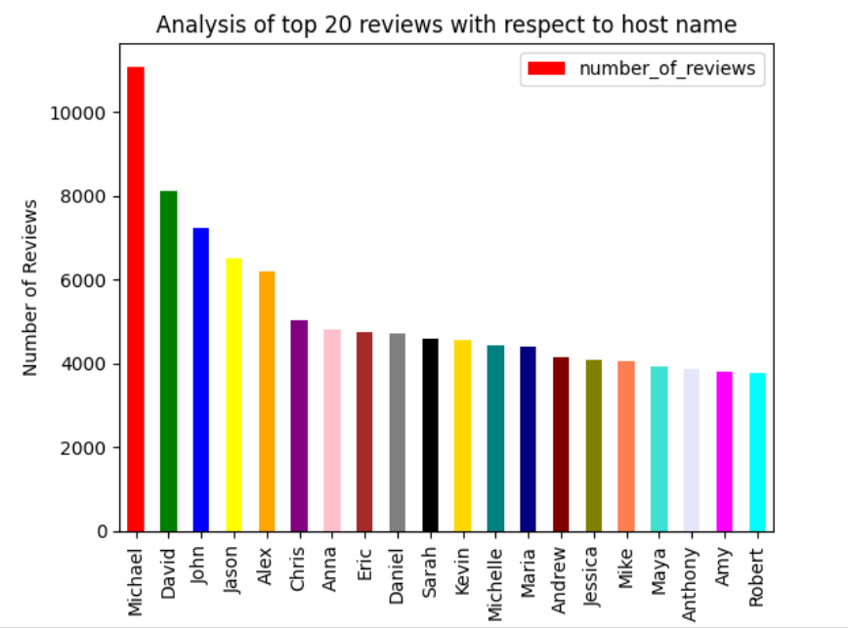

Slide 13
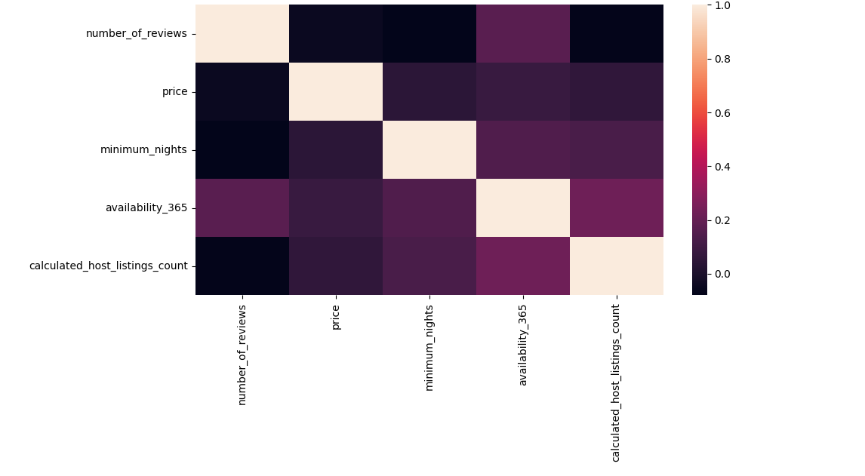

Slide 14
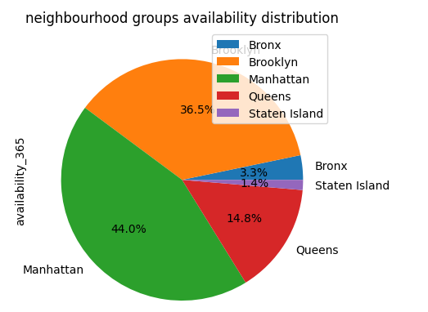

Slide 15
THANK YOU
Mirjam Nilsson
mirjam@contoso.com
www.contoso.com

